Slide 1


SteamBioAfrica:
Project Update 8th September 2023
Turning unwanted woody overgrowth into
clean secure and affordable energy in Southern Africa.
This project has received funding from the European Union’s Horizon 2020 research and innovation programme under grant agreement No 101036401

Slide 2

Overview
What we have achieved
Material Supply
Technology (& Challenges)
Market Understanding
Stakeholder Engagement
Ecology & the Environment
Context
Rationale
Technology
Prior Work
Next Steps
This project has received funding from the European Union’s Horizon 2020 research and innovation programme under grant agreement No 101036401

Slide 3
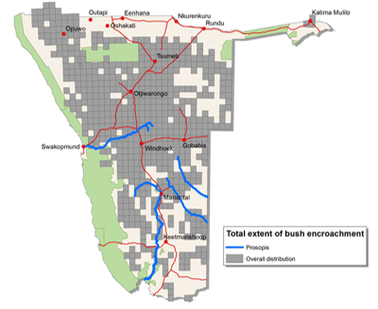
Rationale behind the project
Encroachment & invasives degrade land across Southern Africa
Over 45 million ha of land degraded just in Namibia
Over 120 million ha across Southern Africa
Assume 10 tonnes biomass per ha
450 million tonnes of unused biomass in Namibia
Over 1200 million tonnes across Southern Africa
Global wood pellet market is 55 million tonnes pa
Global coal market is 7000 tonnes pa
Need to create value from this biomass
Make it a resource rather than a problem
To stimulate its sustainable harvesting
This project has received funding from the European Union’s Horizon 2020 research and innovation programme under grant agreement No 101036401

Slide 4
Our Innovative Technology
Superheated Steam Processing:
an established drying technology
Efficient heat transfer, moisture is drawn out of substrate with no crust formation leads to quicker more uniform drying
Our Approach:
Steam released from substrate, once steam saturated drying stops, we continually remove moisture to maintain superheated state, enabling continuous process.
Superheated Steam presents an inert atmosphere it does not react with substrate, results in no reaction compounds formed
Our Innovations:
Elevation temperature of superheated steam process to torrefaction conditions is novel. We can control outputs; clean burning fuels and biochemicals in removed condensate
This project has received funding from the European Union’s Horizon 2020 research and innovation programme under grant agreement No 101036401

Slide 5
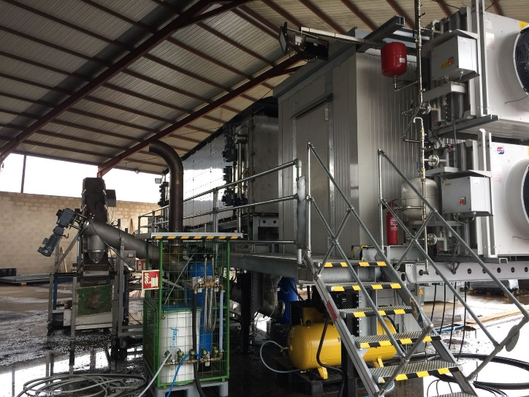
Project Scope
Turn unwanted woody biomass into clean burning fuel with coal like handling and combustion properties.
Industrial users do not need to invest in new boilers or lower efficiencies
Advance on previous SteamBio project
Validated technology in Spanish demonstration
Holistic reach
Robust design
Techno-economic viability
Enable scale up and replication
This project has received funding from the European Union’s Horizon 2020 research and innovation programme under grant agreement No 101036401

Slide 6
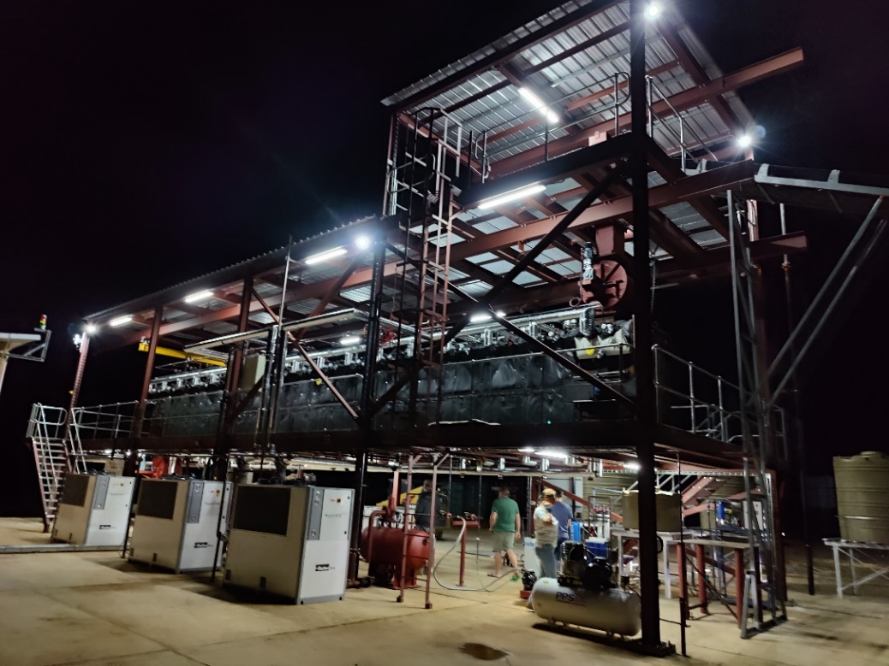
Project Focus
Where we are now?
Energy insecurity
Climate impacts
Encroachment
Rural Unemployment
Gender inequality
Social exclusion
Where do we want to be?
Clean, secure, and affordable energy
Rural Employment
Land Restoration
Gender & Social Inclusion
Local Wealth Creation
This project has received funding from the European Union’s Horizon 2020 research and innovation programme under grant agreement No 101036401

Slide 7
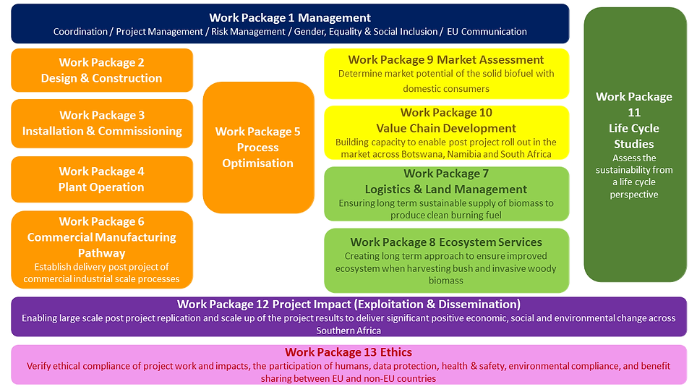

SteamBioAfrica Work Plan
Technology
Work Package 2– 6
Land & Ecosystems
Work Package 7 & 8
Market & Value Chain
Work Package 9 & 10
Life Cycle Studies
Work Package 11
Project Impact
Work Package 12 & 13
This project has received funding from the European Union’s Horizon 2020 research and innovation programme under grant agreement No 101036401

Slide 8
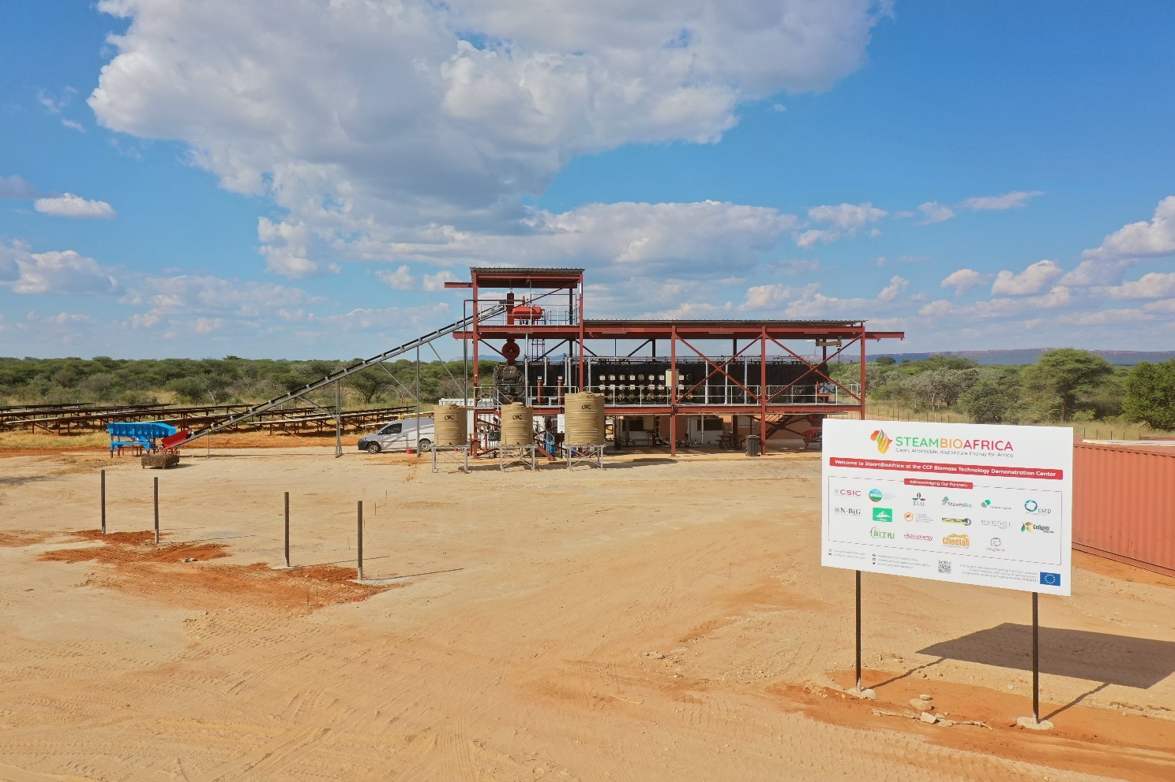
Demonstration Unit at CCF

Slide 9

Project Ambition: Progress to Date
Design
Robust & resilient Temperature up to 260ºC
Build on prior work
Confirming
Benefits for & in Africa
Profit & Value
Clean burning high value fuel
Industry & households
Social & environmental sustaining
Stimulate bush clearance
Soil restoration
Optimise logistics
Job creation
Process being optimised to
input feedstocks and market demand
Preparing & progressing post project Planning
This project has received funding from the European Union’s Horizon 2020 research and innovation programme under grant agreement No 101036401

Slide 10
What Next?
Commissioning and Operation at CCF:
Operate for 12 months (250kg/hour 24/7 operation)
Produce over 500 tonnes of torrefied clean burning fuel from encroacher bush
Demonstrating and Validating:
Technical and economic robustness
Market acceptance (landowners, industry, and domestic consumers)
Positive sustainable social and environmental impact
Route to market with strong local benefit focussed on domestic demand
.
Developing:
Business Plans
Local supply and value chains
Secondary co-product opportunities
Customers and investors
To enable Large Scale Post-Project Roll-Out
This project has received funding from the European Union’s Horizon 2020 research and innovation programme under grant agreement No 101036401

Slide 11















15 partners
2 continents
8 countries
Researchers & Academia
Industry & Entrepreneurs
This project has received funding from the European Union’s Horizon 2020 research and innovation programme under grant agreement No 101036401

Slide 12

Do you have any questions?
www.steambioafrica.com
huw.parry@networkneweurope.com
This project has received funding from the European Union’s Horizon 2020 research and innovation programme under grant agreement No 101036401

