Slide 2
The present and future outlook of the Namibian encroacher bush-based biomass thermal processing industry
Namibia Biomass Research Symposium 2023
Igniting the Growth of the biomass sector in Namibia
Charles Rashama^{1*}, Progress Kashandula¹, Bruce A. Brewer², Colin Malan Lindeque³
¹Namibia Biomass industry Group, 5 von Braun Street, Southern Industrial Area,
Windhoek, Namibia. ²Cheetah Conservation Fund, P.O. Box 1755 Otjiwarongo, Namibia. ³Carbon Capital Pty Ltd, 35 Crohn Schanzen Road, Windhoek, Namibia.
Gross Barmen Resort
7 September 2023

Slide 3
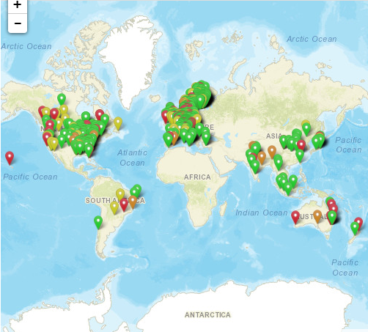
Introduction
Namibian bush encroachment highlights (Peter Heck, 2021)
3-5% per annum growth versus 1% bush usage
30 - 45 million ha of Namibian land encroached
60% commercial and 40% communal land
300 - 450 million tons untapped biomass stocks
1.4 million tpa use in various bush value chains
Predominantly charcoal production
650 producers and 6000 workers
No.1 exporter in Africa
No. 12 global production
Current efforts insufficient to control bush encroachment.
Additional value chains are possible through biomass thermal processing
Fig 1: Biomass Processing Plants Database (IEA, 2023)

Slide 4
Thermochemical Technologies – Maximize local benefits from encroacher thermal processing
Different biomass thermochemical pathways: Conditions & Products (Mishra & Upadyay, 2021)
£€$, Cleaner environment, Jobs
Opportunities for Namibia
Diversify biomass value chain to include new high value product classes
Sustainably control bush encroachment at significant scale
First commercial scale exploitation in Africa - Better returns to early investors
Potential for registering project under UNFCC Clean Development Mechanism
Heat and Pressure
Diversity in operating conditions, scale of operation hence Capex and Opex requirements.
Diverse products hence lower risks exposure. Scope for serving local interests – jobs, products, expertise in R & D, etc

Slide 5
Direct Combustion
Overview
Mature technology globally being used for power, process heat and heating. (wood, woodchips, pellets, powder, sugar bagasse, forestry residues)
European industry shifting from direct combustion into producing high value products mainly due to reduction in incentives.
Main advantage is that technology has low pretreatment costs.
Cons
Health risks associated with domestic firewood use
Co-firing with low calorific value woodchips
Transport of low density wood chips
Decomposition risk during storage
Poor friability
Opportunities in Namibian
A handful of Namibian private sector plants use combustion for thermal energy generation (Ohorongo Cement, Breweries)
NamPower 40MWe Otjikoto Biomass Power plant Development is ongoing
50% of Namibians still rely on wood fire for cooking and heating in rural areas (National Energy Policy, 2016).
Recommendations: Namibia should consider torrefaction as a pretreatment to wood before combustion

Slide 6
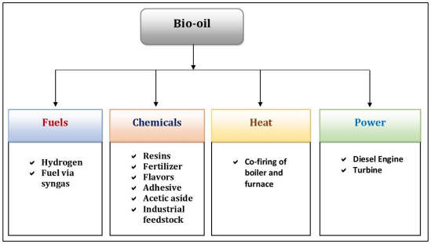
Pyrolysis (Slow, Intermediate & Fast)
Overview
Opportunities in Namibia Context
Global priority is on biocrude versus charcoal production.
Main advantage is process flexibility towards a broad product selection (Uddin et al, 2018)
Among top 10 charcoal exporters globally.
Scale of operations involved can not stop encroachment.
Major challenges in Namibia are
Limited local use of product
Pollution (smoke and emissions)
Labour issues
Current charcoal volumes do not significantly help control bush encroachment on national scale
Recommendations: Namibia should explore biochemical recoveries from pyrolysis plants
Cons – If not managed properly has extensive SHE and energy issues (fines, fumes, drying needs)

Slide 7
Torrefaction (Mild Pyrolysis)
Overview
100 registered patents, 6 different technologies commercialized. 20 companies in operation. More than 60 tech developers globally. IBTC, independence since Jan 2024. (IEA, 2015)
Advantages
Easier shift from coal to biomass
Products fit both industrial and home use
Process effluents can be valorized into process heat gases or biochemicals.
Cons
Need for small sized feed increase capex on milling, screening and subsequent pelletizing.
Opportunities for Namibia
No operating entity in Namibia at the moment.
One pilot plant (2010), Nampower feasibility studies (2012) and SteamBioAfrica (2023).
Opportunities exist to replace imported coal – NamPower, Breweries, Slaughterhouses and Cement and other industries
Wood use in household cooking/braiing can also be replaced
Recommended
Subsidies for torrefaction investments or penalties for CO₂ emissions to motivate investments (Government).
Optimisation to ensure consistent product QC results (R & D institutions)
Develop product marketing channels (Industrialists)

Slide 8
Hydrothermal Liquefaction (HTL) or Hydrothermal Carbonization (HTC)
Overview
Opportunities for Namibia
This tech is still at R & D stage with extensive research happening around the globe
The desired product is liquid biocrude for subsequent hydrotreating into various fuels and platform chemicals
Gases and biochar are byproducts
Advantages
Applicable to wet biomasses hence better energy saving in avoiding drying
Comparative LCA studies showed that HTL emits significantly lower GHG than pyrolysis.
Diverse products
Cons – Energy required for high pressure & product recovery
NUST/UNAM can partner other global research institutions in HTL to build local capacity and enable Namibia grabbing of commercialization opportunities once the breakthroughs are realized.
Scope for student exchange programs (Staff development fellowships)
Government scholarships with bonding arrangements at NUST/UNAM.
Potential for regional hub Research Institute, CoEs, CoCs: proximity to the different biomass resources.
Private sector support through scholarships/bursaries

Slide 9
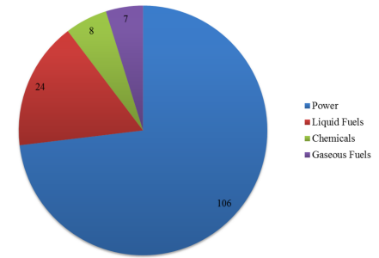
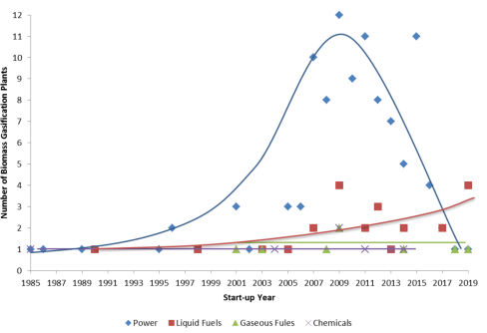
Overview: Gasification
Global Outlook 1980s to date
More than 150 operational plants globally (IEA, 2021)
More than 50 plants planned or on hold
Investments (Europe) shifting from power to liquid fuels. Chemicals and Gas fuel almost constant

Slide 10
Gasification: Namibian Opportunities
Advantages
Low risk of failure -A tried and tested technology at global scale (esp with coal)
Ready local/regional market for products especially chemicals
Technology can take different wood species
Product yields profile can be customized
Cons
The high demand for water in operations
Limited products QC monitoring and certification expertise
High capital and maintenance costs
Limited personnel experience to operate and maintain plant
There has been a few attempts to run small gasification plants in Namibia in the past – Different extents of success.
Namibia could focus on capacity building and water resources to fully exploit gasification

Slide 11
Overall Recommendations
Short Term
Combine Charcoal pyrolysis business with biochemical oil production and upgrading (Current Charcoal Producers).
Proceed with the Combustion based power plant projects but incorporate provisions for retrofitting torrified products. Accelerate torrefaction project implementation (NamPower).
Incentivise torrefaction project implementation (Government)
Medium Term
Consider investing into water resources to enable full exploitation of the Gasification technology at commercial scale. Build capacity for plant operation, maintenance, supply chain for spares (NUST/UNAM/SMES/Private Sector)
Long term
Invest in biorefineries (Biomass Industrial Parks) – Feedstocks, Biofuels, Biochemicals, Biofertiliswers, etc (N-BiG)
Invest in Research and Development – Research Centres, CoC, CoEs, etc (NUST/UNAM)

Slide 12
Thank You
Colin
Charles
Progress
Bruce
Acknowledging

